Slide 1
forget complaints about compliance
Notes:
Hello everybody, in the next 4 minutes, we will make you forget all your complaints about compliance

Slide 2
“Our compliance system is working fine”
Notes:
- When companies tell you that their compliance systems works well – you can be sure that, most likely, this is not true.
- We know it all from the daily news: Stories on compliance scandals are the norm and not the exception.
- In fact, recent academia shows that almost 20% of employees observe corruption related misconduct.

Slide 3
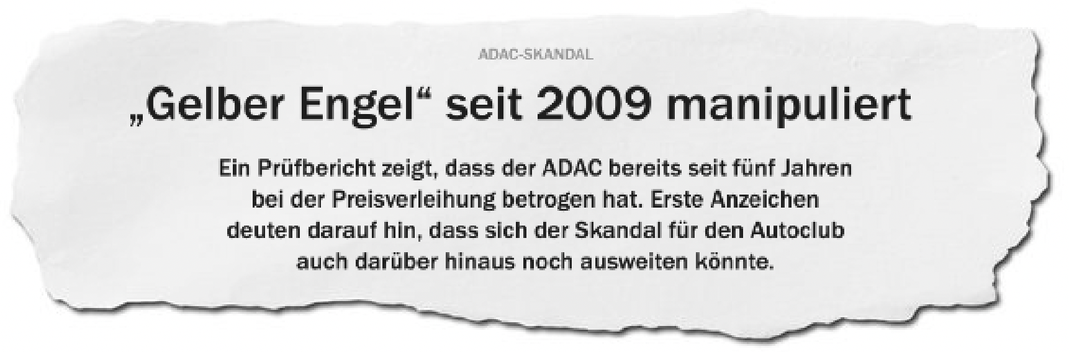



“Our compliance system is working fine”
Notes:
- When companies tell you that their compliance systems works well – you can be sure that, most likely, this is not true.
- We know it all from the daily news: Stories on compliance scandals are the norm and not the exception.
- In fact, recent academia shows that almost 20% of employees observe corruption related misconduct at work

Slide 4
Employee training is the most important challenge
Explanation
The ongoing trend: Companies become larger and more international.
Notes:
Why is this the case?
We see an an ongoing trend of companies becomming larger and larger and more international over time

Slide 5
Employee training is the most important challenge
Explanation
The ongoing trend: Companies become larger and more international.
The result: Regulations and compliance requirements are becoming longer and more complicated
Notes:
As a result, the legal environment in which these companies operate in gets incredibly complex

Slide 6
Employee training is the most important challenge
Policy management challenges in %, N = 729
Explanation
The ongoing trend: Companies become larger and more international.
The result: Regulations and compliance requirements are becoming longer and more complicated
The problem: Employees are overwhelmed by regulations. Status quo: If rules are not found quickly, employees act on gut feeling.
Notes:
Therefore, it comes as no suprise that employees are overwhelmed by all the different regulations they have to keep in mind.
And at the same time, companies complain that the compliance training of employees is the most difficult challenge they currently face.

Slide 7
Demo Time!
Notes:
Hello everybody, in the next 4 minutes, we will make you forget all your complaints about compliance

Slide 8
We provide lightning-fast and easy-to-understand answers
Lightning-fast Access to Information
Easy-to-understand instead of legal jargon
Highly scalable 24/7 availability and little costs
Notes:
Why now: Fortschritte in der Technologie
We thought about “lets not just create an app or a website but a solution that is at any time only a fingertip way”

Slide 9





Our solution is based on three stages of GPT-3
Search First, the employee's question is matched against all documents to identify the document with the correct answer.
Completion & Summary Based on the question and the correct document, a custom-fit answer is generated. This is summarized to be as understandable as possible.
Suggestion Based on the answer, further information on important keywords is suggested to improve the understanding of the employee

Slide 10
An attractive market beyond compliance
Our business model...
...has high growth prospects
Chatbot market revenue 2020 to 2027 in Mio. $
Perfectly customized:
Individual customer documents
Pay-per-use:
Adapt to company size
eGRC market size from 2019 to 2024 in Bio. $
Product expansion:
Lightning-fast search beyond compliance topics
CAGR:
10.3%
2019
2024

Slide 11



Hyped? Let’s connect!
Andy Chen
Michael Amroudi
Leonie Freisinger
Robotics, Cognition, Intelligence, M.Sc.
Management & Technology, M.Sc.
Mechatronics & Robotics, M.Sc.
SWE
AI/ML
UX/UI
Strategy
AI/ML
C++
Innovation
Finance
Product Development

Slide 12


Slide 13
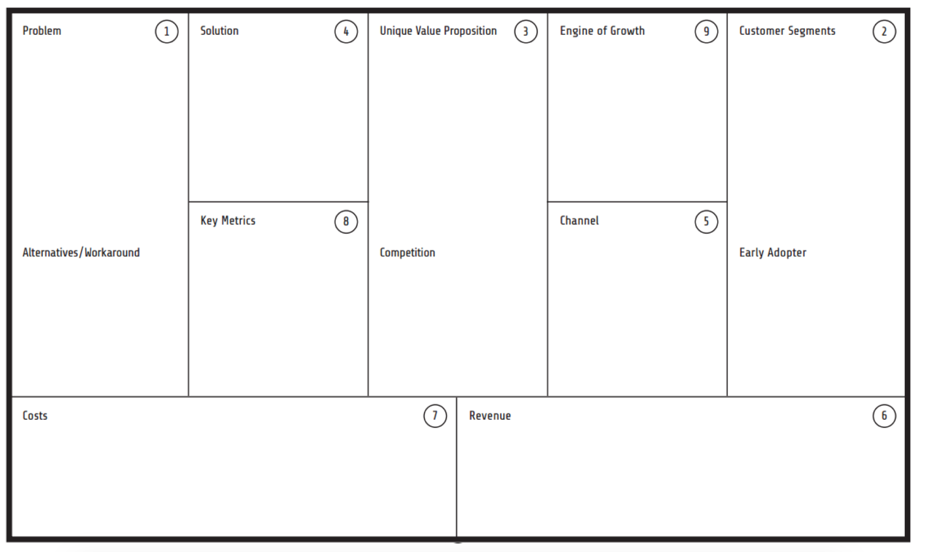
Appendix: Lean Business Model Canvas
Companies are struggling with training their employees on compliance regulations
Highly advanced & intelligent chatbot using GPT-3
Enable users to quickly find all the information they need – only a fingertip away
Word of mouth
Large (public) companies
Easy-accessible browser extension
Paid Ads
International companies
They have in common that they have compliance documents with hundreds of pages
Employees constanly feel overwhelmed by the amount & complexity of compliance regulations
Number of Questions
(Hopefully) TUM Venture Lab
Hard-to-find SharePoint Folders
Not GPT-3 Related
Firms that recently had a compliance scandal and are now under pressure to act
User Growth
Pilot Phase with Siemens
Asking the legal department (takes a lot of time)
Not GPT-3 Related
Direct Sales
Gut feeling
GPT-3 Fees
Hosting Fees
Pay-per-use based on the number of questions
Developers

